Slide 1
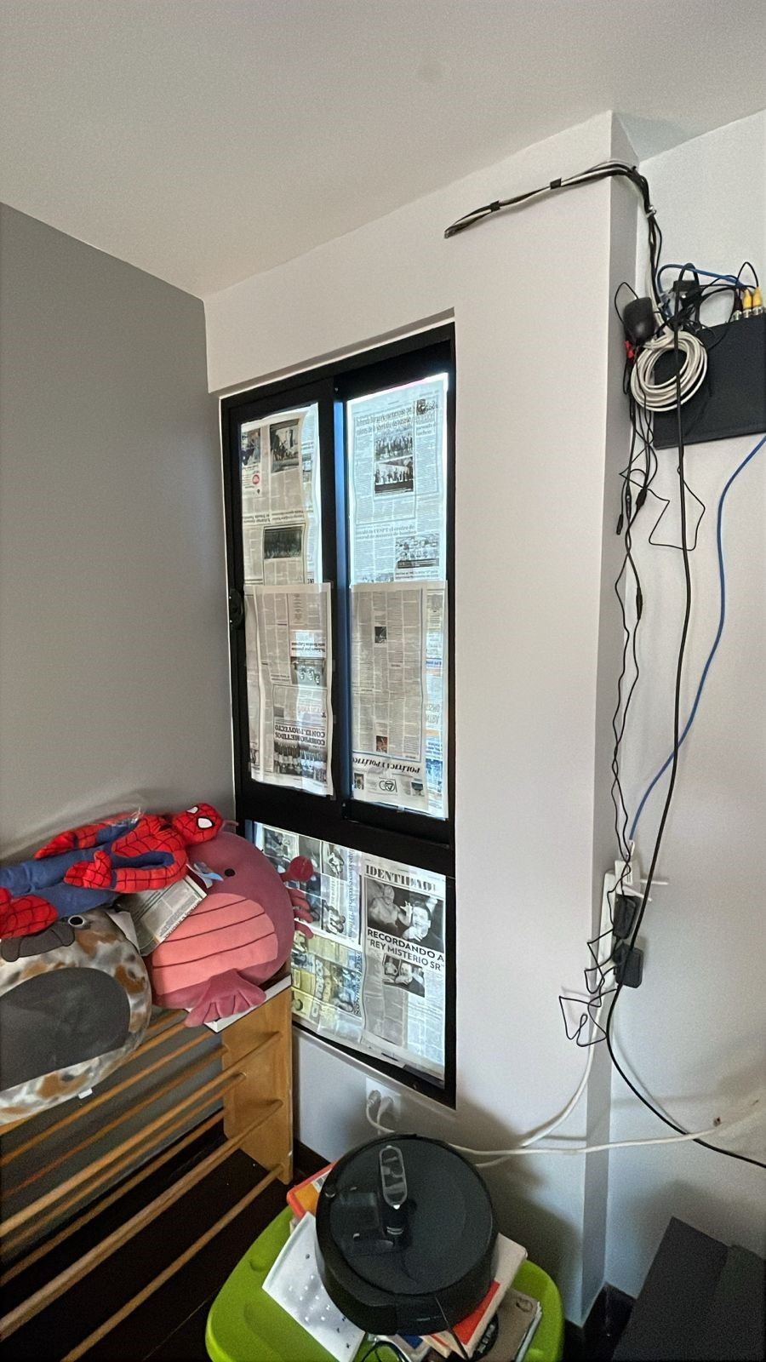
MARA ZULEY
Cortina ripplefold, panel R
Instalacion a pared.
-CRETA CLOUD
-KN-FAB-0599
44.5’’
98.25’’

