Slide 1
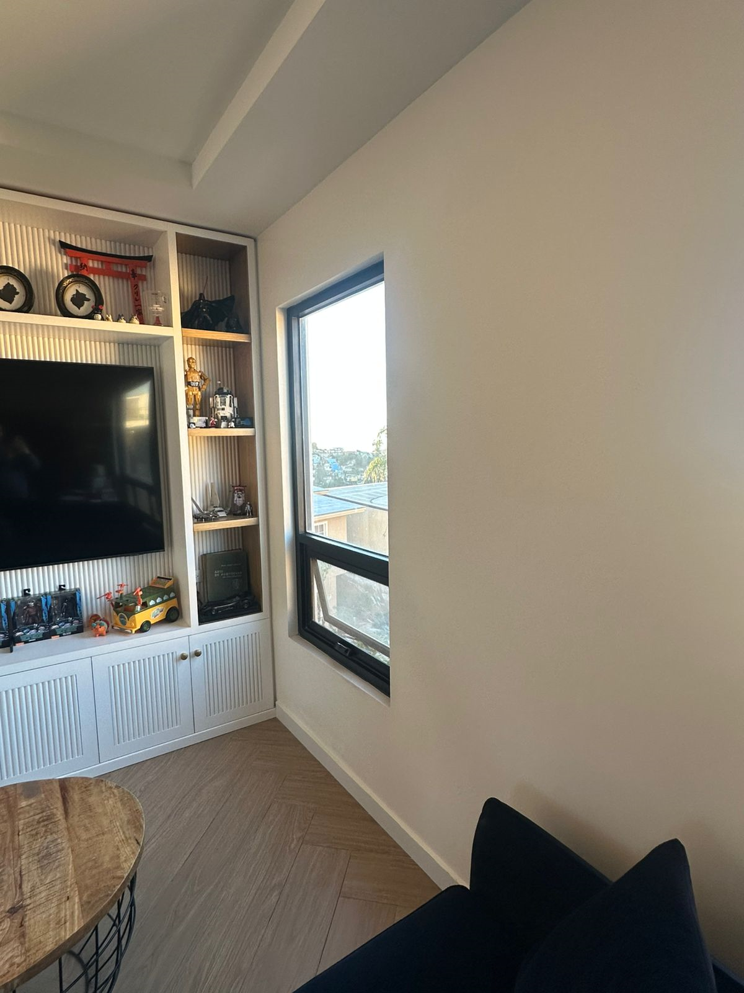
JOSEPH KRILE
A
CORTINA SHEER + BLACKOUT
TELA MOSHROOM ELITEX
PRIMARY BATISTE IVORY
BLACK OUT PNL R
SHEER TWO WAY
50’’
100.25’’

Slide 2
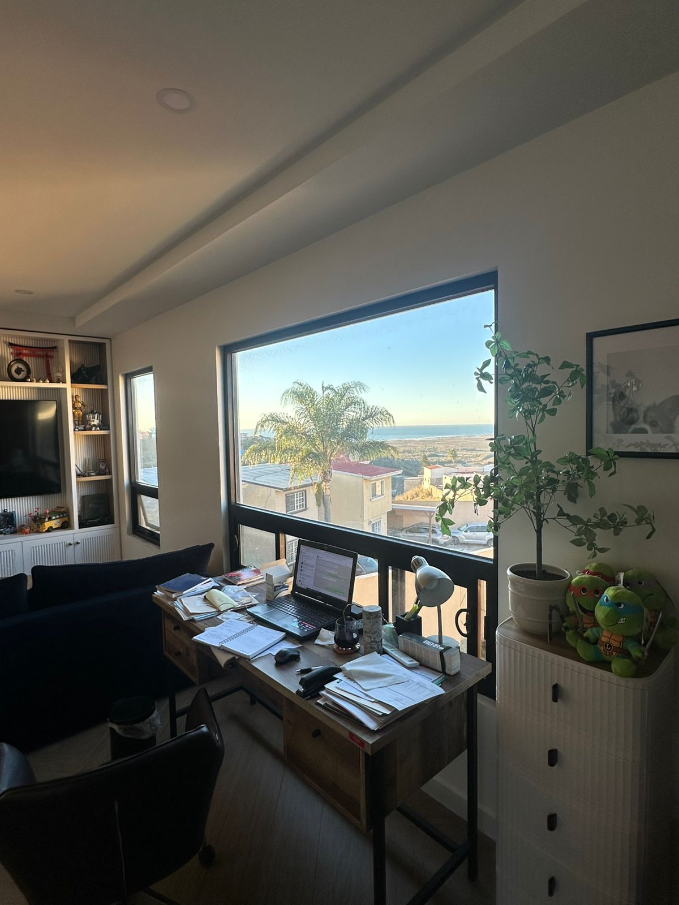
B
CORTINA SHEER + BLACKOUT
TELA MOSHROOM ELITEX
PRIMARY BATISTE IVORY
BLACK OUT PR
SHEER TWO WAY
95’’
100.25’’

Slide 3
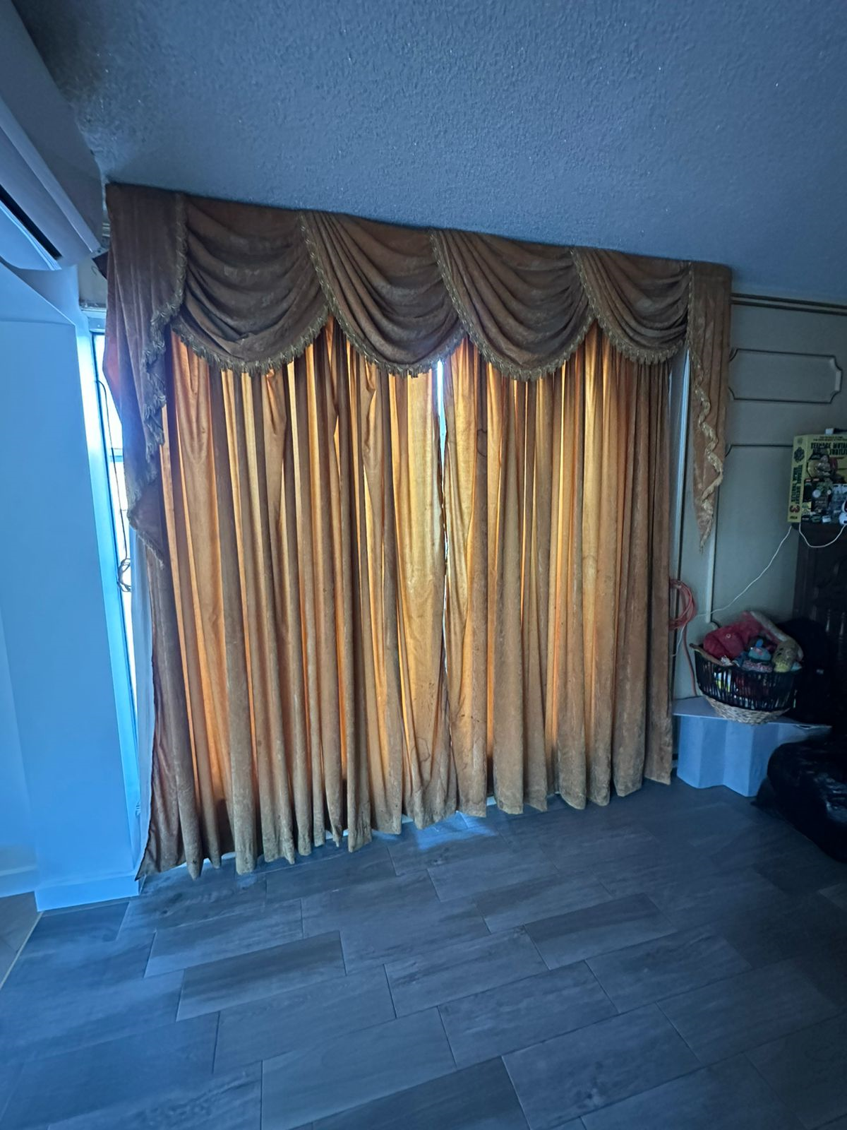
CORTINA SHEER + BLACKOUT
TELA MOSHROOM ELITEX
PRIMARY BATISTE IVORY
BLACK OUT PR
SHEER TWO WAY
C
100’’
96.5’’

Slide 4
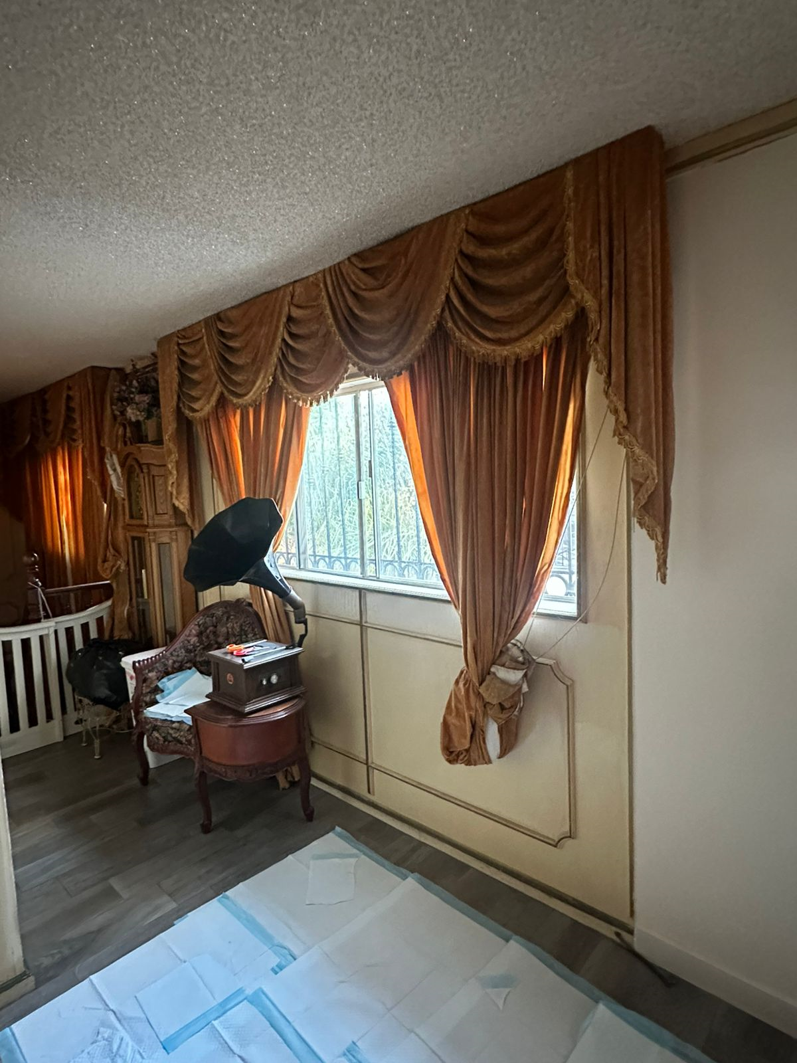
D
CORTINA SHEER + BLACKOUT
TELA MOSHROOM ELITEX
PRIMARY BATISTE IVORY
BLACK OUT PR
SHEER TWO WAY
95’’
92.25’’

Slide 5
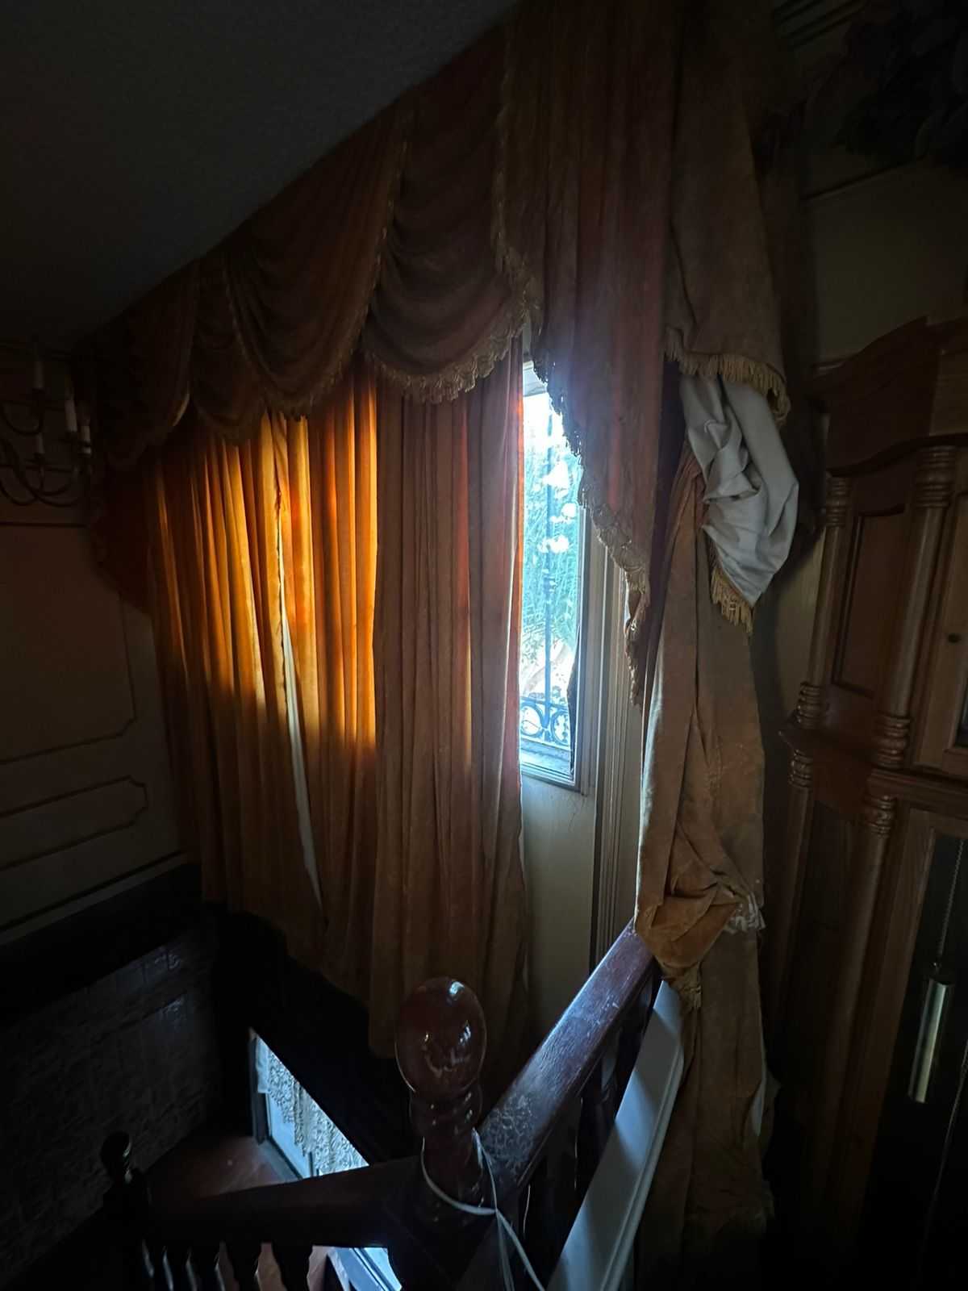
CORTINA SHEER + BLACKOUT
TELA MOSHROOM ELITEX
PRIMARY BATISTE IVORY
BLACK OUT PR
SHEER TWO WAY
95’’
92.25’’

