Slide 1
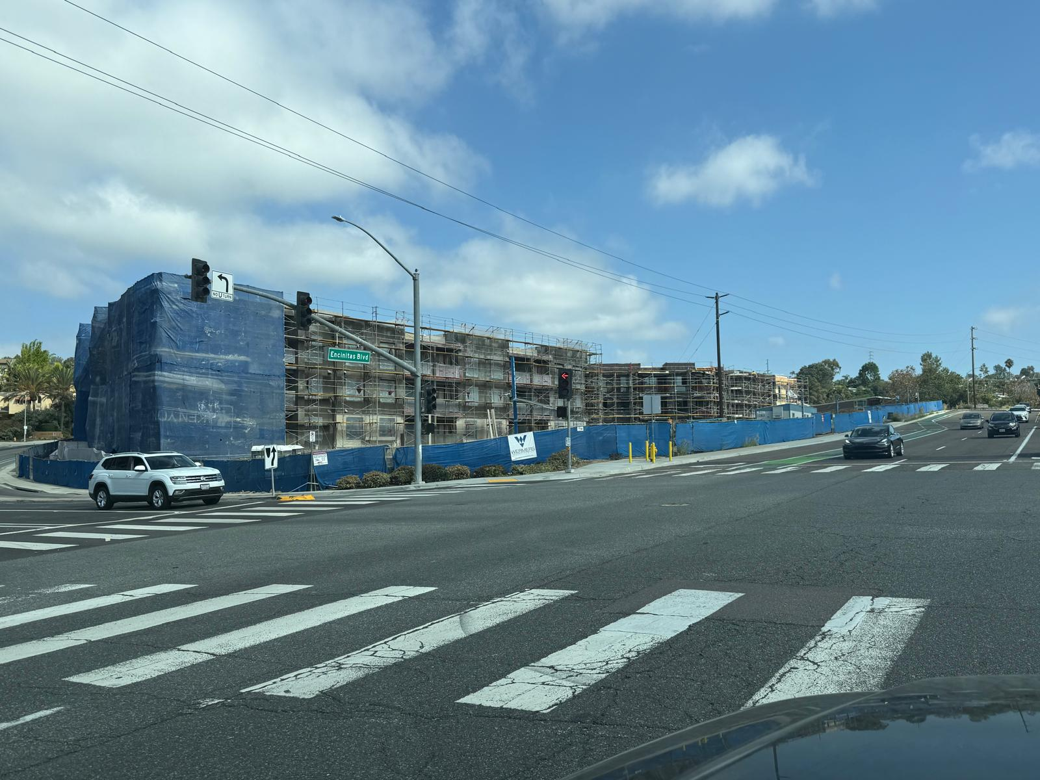
SUNSHINE GARDENS APARTMENTS
ENCINITAS CA

Slide 2
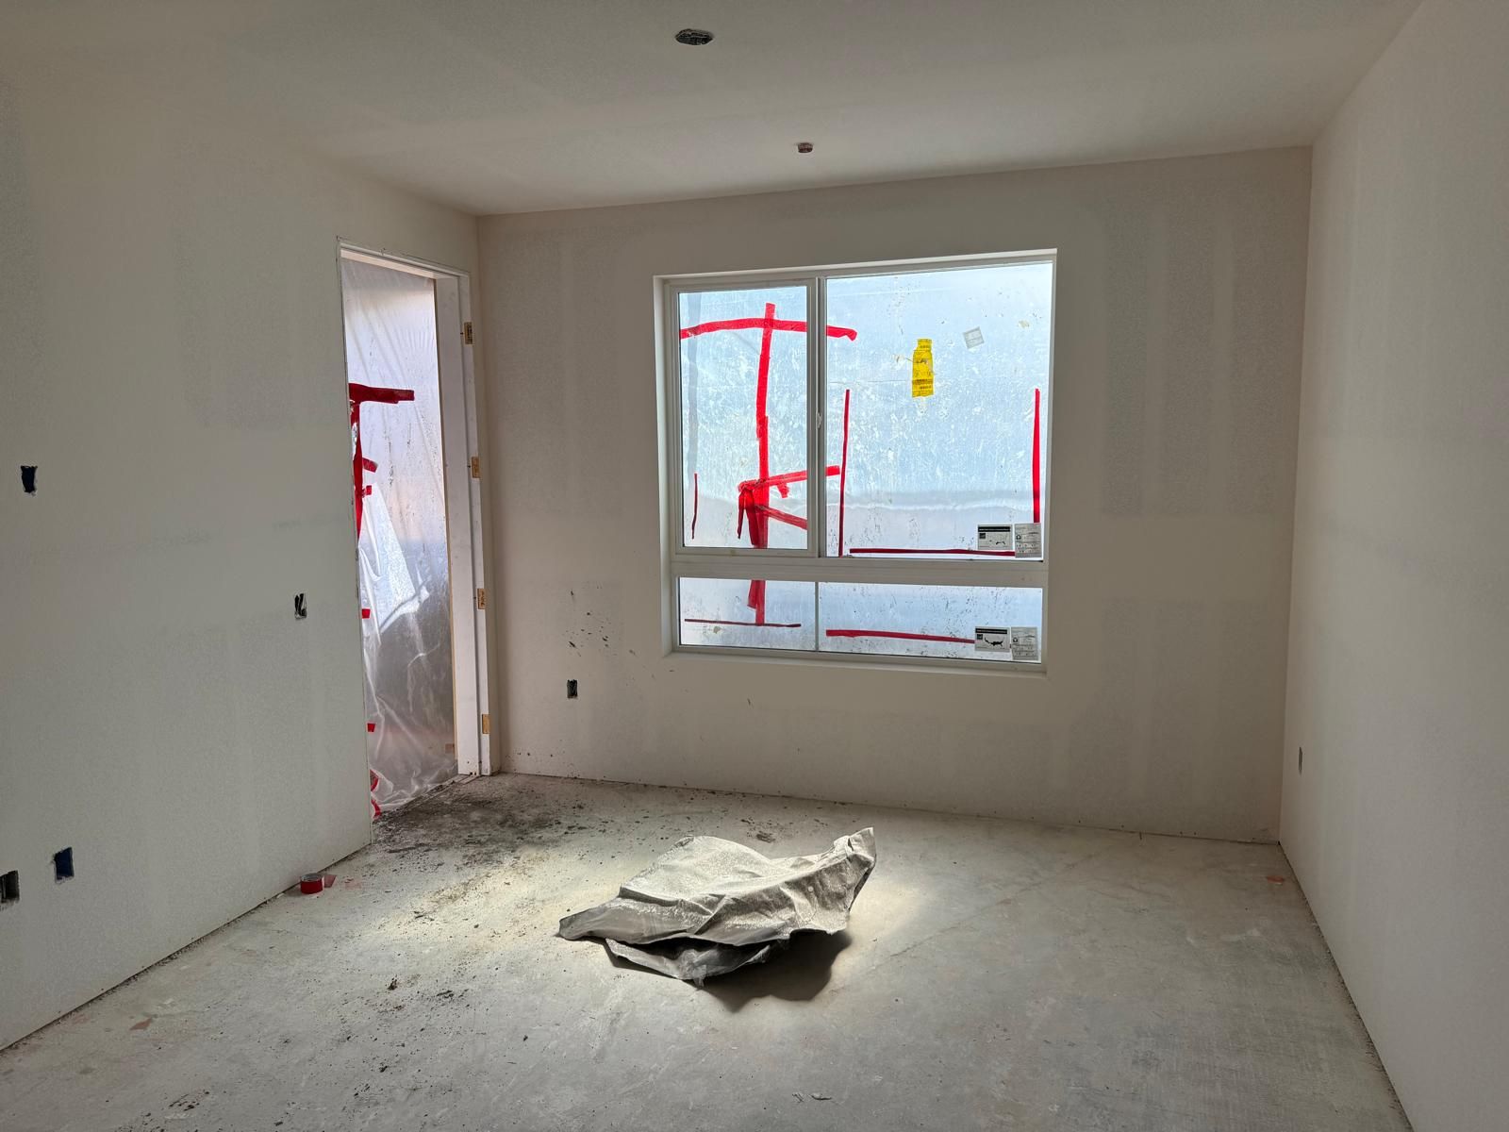
TGR
LR
LR DOOR

Slide 3
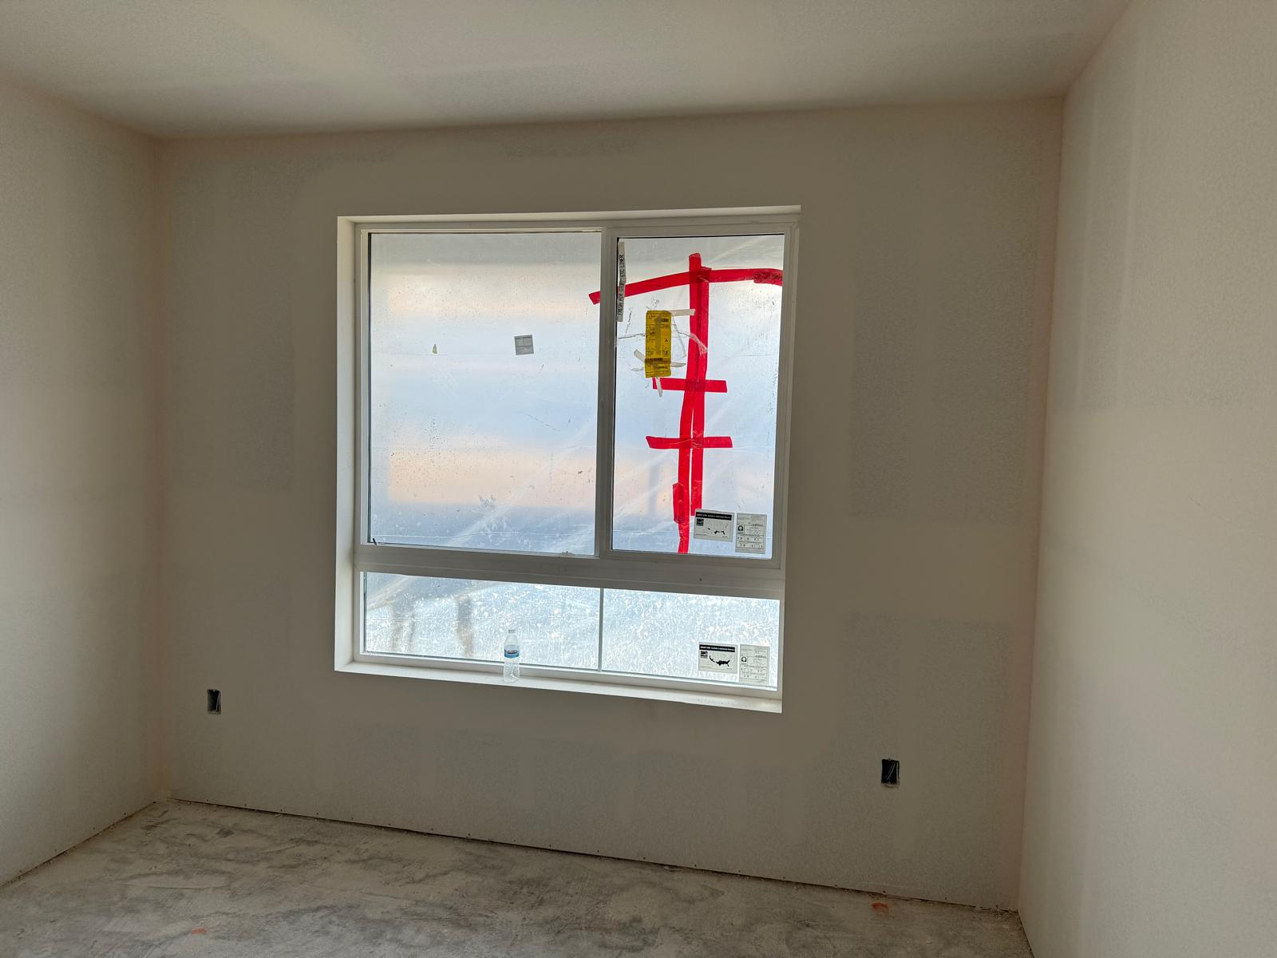
BR A

Slide 4
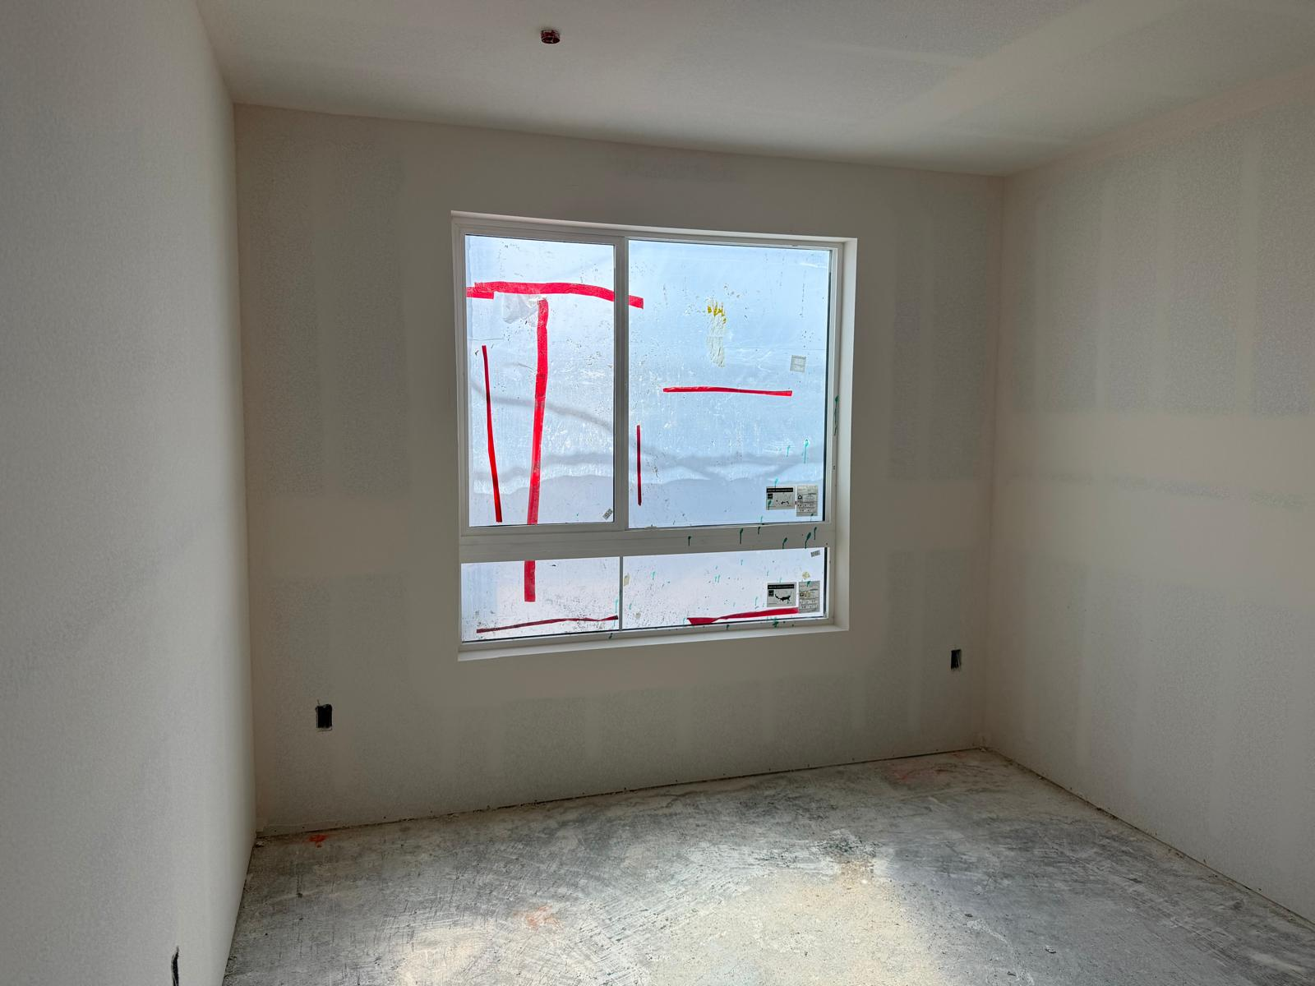
BR B

Slide 5
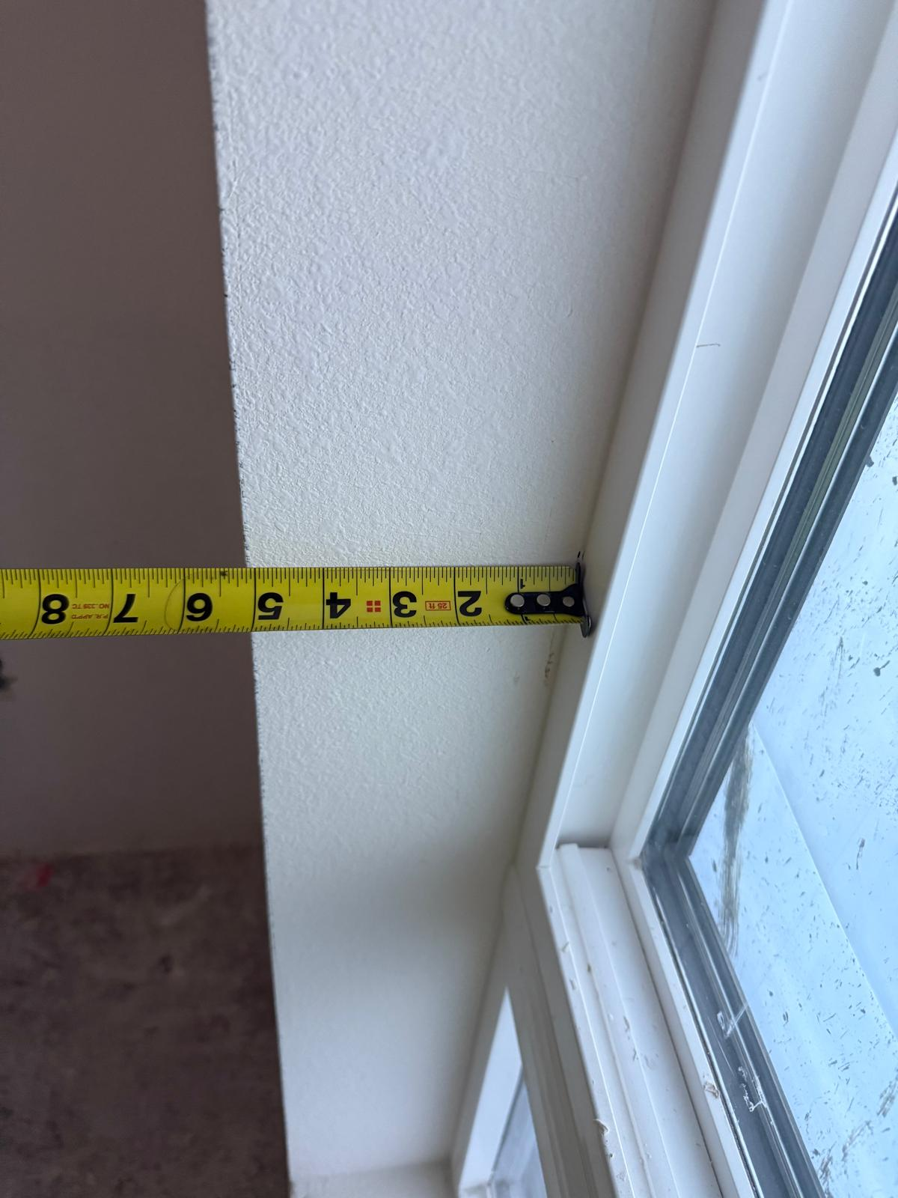
WINDOW DEPTH

Slide 6
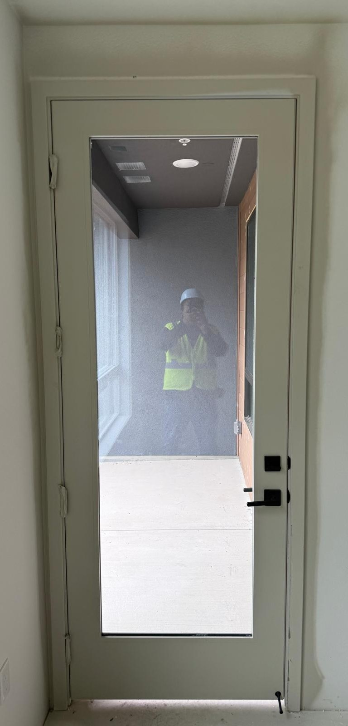
3.75’’C
26.500
4.25’’C
80.750
28.500 FABRIC SIZE
1.000
11.000’’

Slide 7
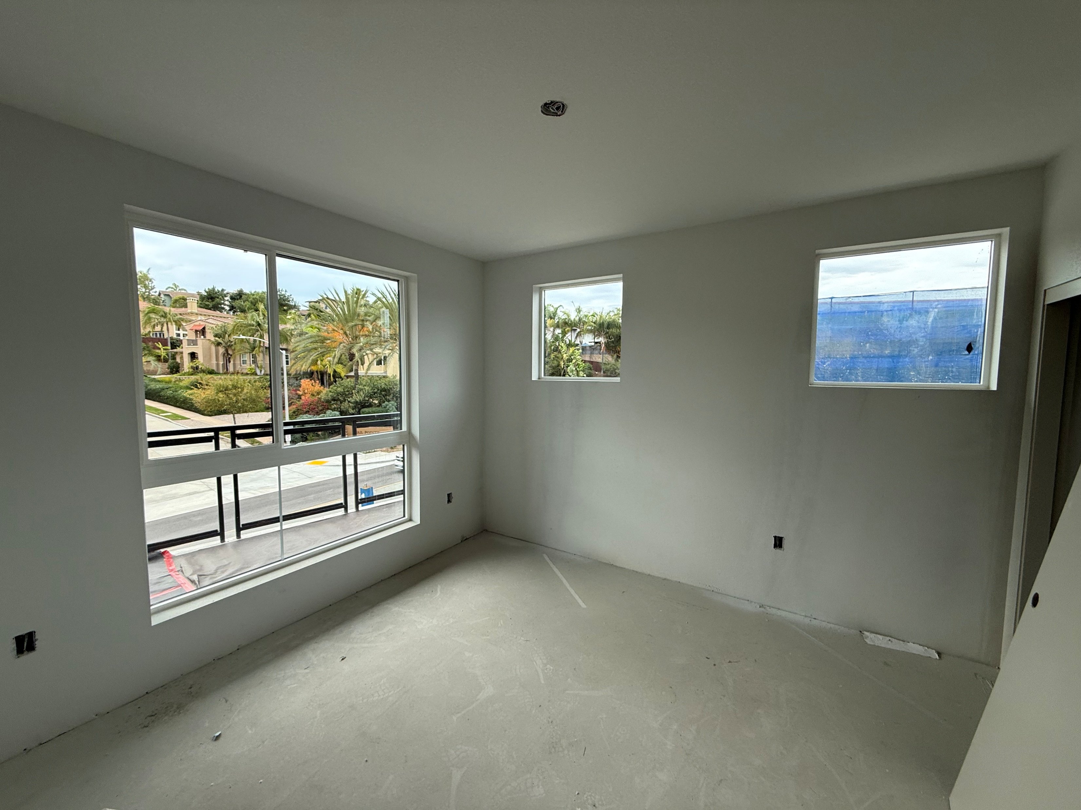

Slide 8
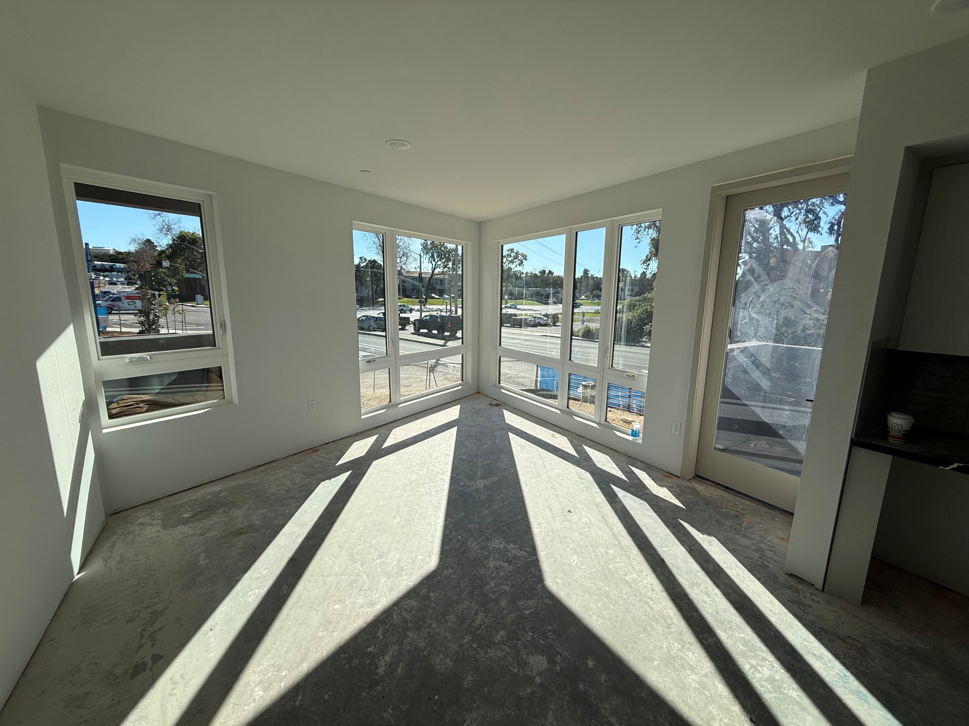

Slide 9
