Slide 1
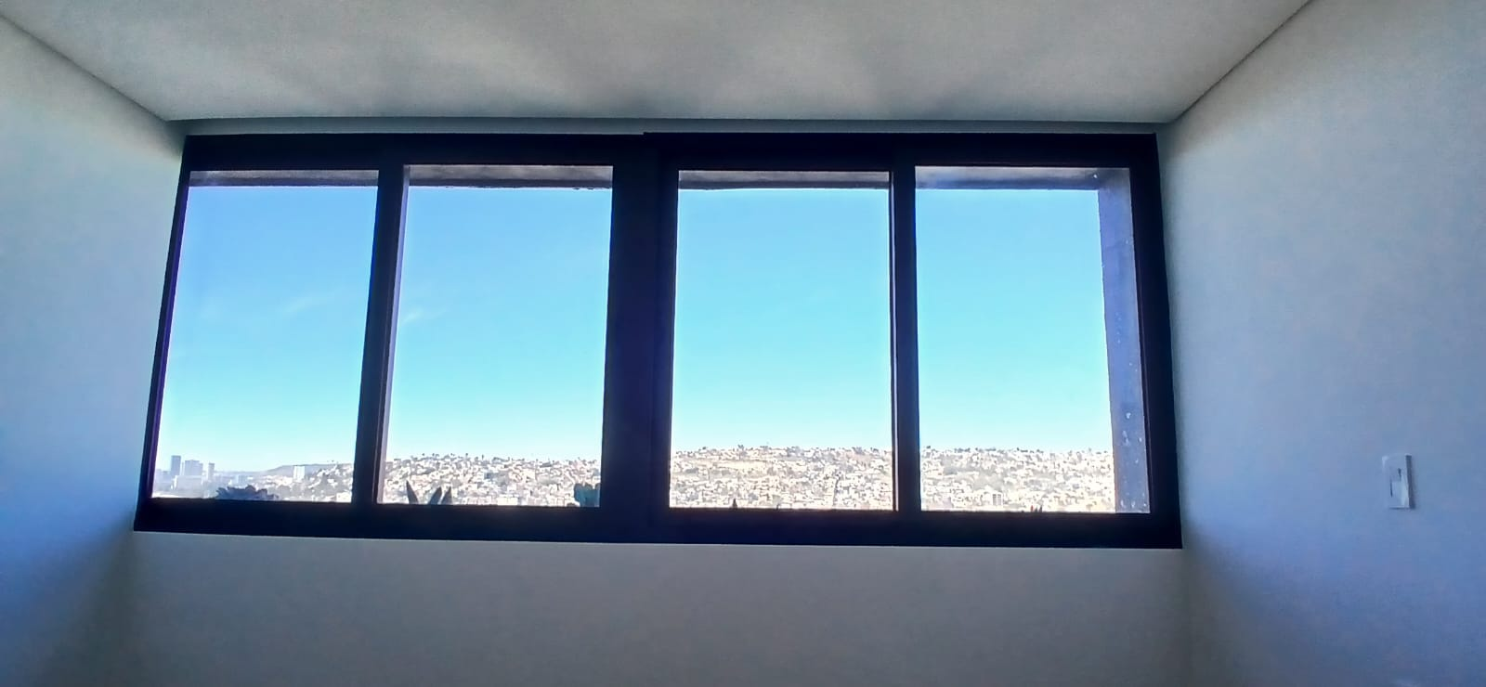
LINK 1401B
TODO ES INSTALACION A TECHO.
SISTEMA MANUAL
BO OHIO STONE
REC PRINCIPAL
67.25’’
71.5’’
68’’

Slide 2
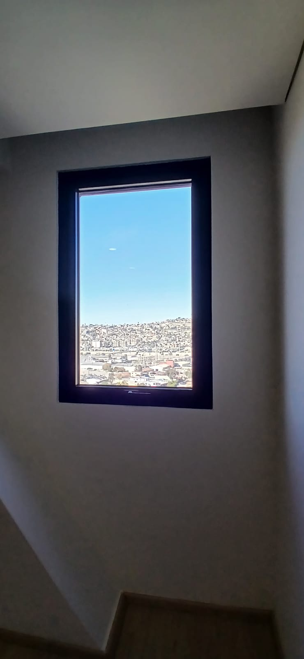
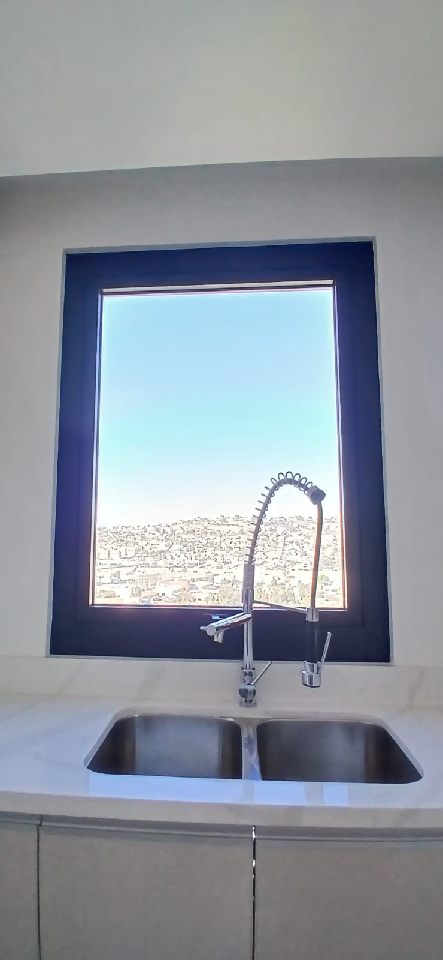
REC SECUNDARIA
COCINA
BO OHIO STONE
SC. BASIC TOBACCO
41’’
47’’
64’’
62’’

Slide 3
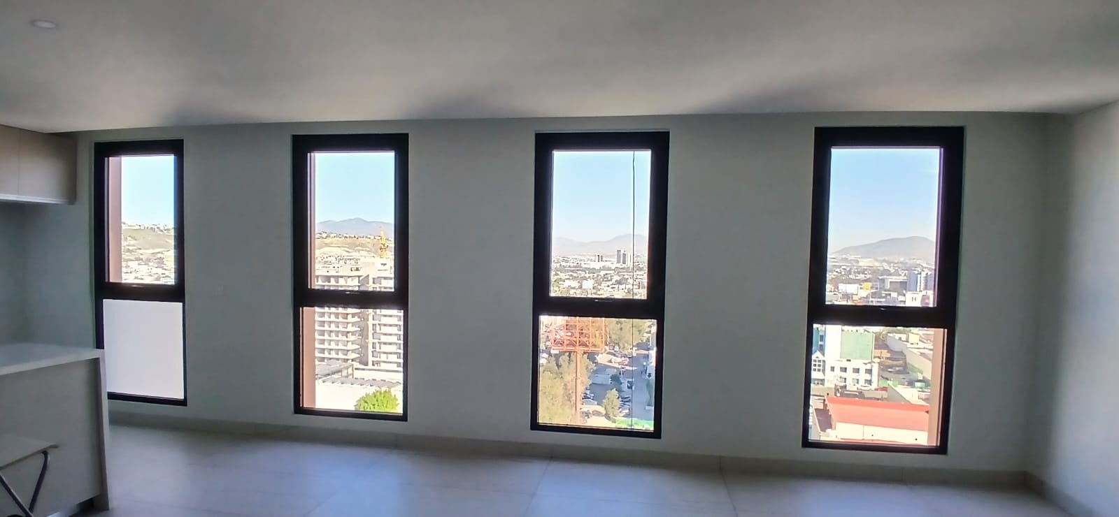
SCREEN BASIC TOBACCO
43.5’’
98’’

Slide 4
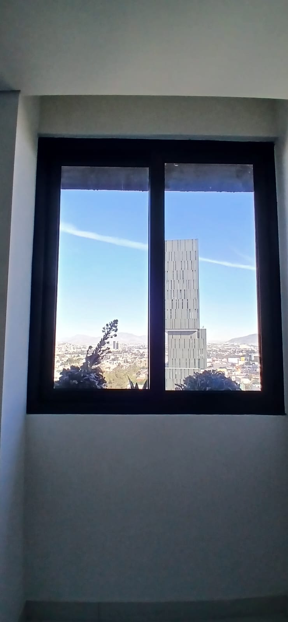
50’’
70’’

