Slide 1
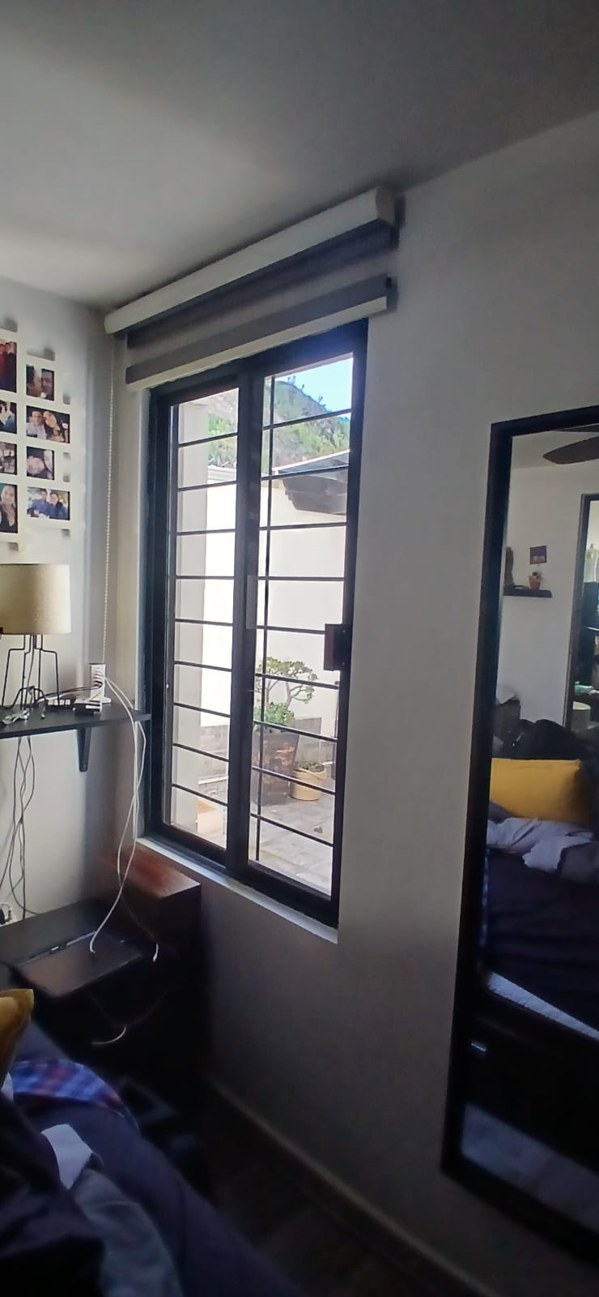
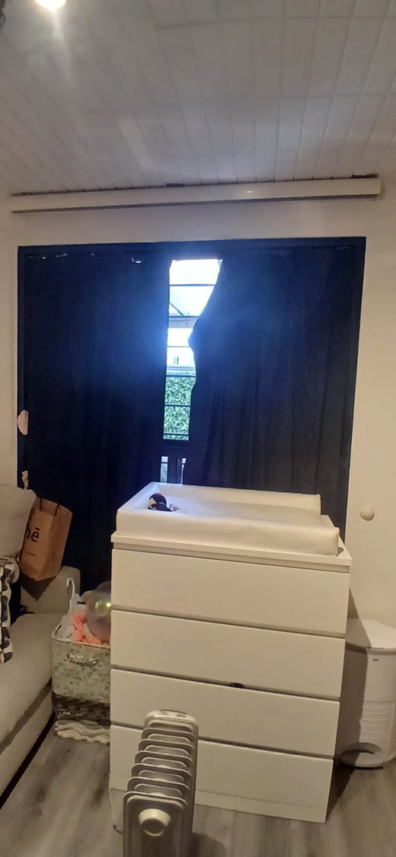
REC PRINCIPAL
REC BEBE
40’’
68’’
CORNISA+SIDE CHANNEL+SILL CHANNEL
CORNISA+SIDE CHANNEL+SILL CHANNEL
65’’
65’’

